Slide 1


THE DATA DECODERS
BY:
MONIKA, HIMANSHI, SHIKHA, HIMANSHI
UNDER THE GUIDANCE OF :
ANAND SINGH
SDE, AMAZON

Slide 2


INTRODUCTION
WHAT ARE WE DOING
Twitter sentiment analysis of last mile delivery, discovering trends and new insights.
WHY TWITTER
According to statista, Twitter has gone from 33m monthly active users in Q1 of 2010 to 335m in Q1 of 2018. Brandwatch reports that there are 500 million tweets daily which means around 6k tweets per second! Twitter is a veritable encyclopedia.
LAST MILE DELIVERY
In a product's journey from warehouse shelf to customer doorstep, the "last mile" of delivery is the final step of the process — the point at which the package finally arrives at the buyer's door.
‹#›

Slide 3
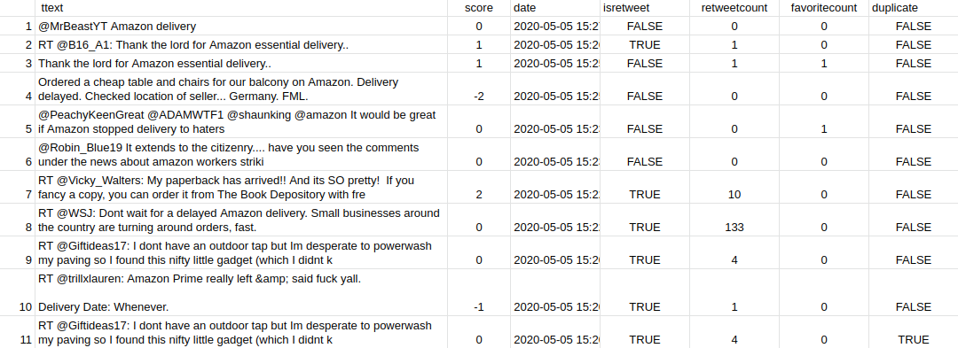
INTRODUCTION
MISSION STATEMENT
Analyze the trends in last mile delivery through twitter sentiment analysis
DETAILS
Compared the delivery sentiment of states through heat map.
Delhi
Bangalore
Mumbai
Uttar Pradesh
Haryana
Overall positive negative and neutral opinion globally
Harvested 10k tweets
Calculated Sentiment Score and polarity for each tweet through Lexicon based approach.
1 for positive , 2 for more positive
-1 for negative, -2 for more negative
0 for neutral
Analysed the issues in Last Mile delivery and drew relative chart
Harvested tweets for each issue: Fake product, Late Delivery, Damaged order Received, Delivery Guy Behaviour,Packaging Issue, Refund issue, Return
Globally and state wise comparison
Which issue is more prevalent
Which state has better delivery
Are the delivery trend different in different states.
Tableau to visualise the data to reveal the insights.

Slide 4





TOOLS

Slide 5









KEY STEPS:
Twitter Developer Account
Connect R to Twitter
R libraries
(ROAuth,
RCurl, httr, twitteR)
Tweet Harvesting
Refine the Harvesting
Meta Data
Text Cleaning
Calculating Sentiment Scores
Data Gathering and Export

Slide 6
INDEX
1. PREPARING AND EXPLORING DATA
2. ANALYZING THE DATA
3. VISUALIZING THE DATA
4. PROJECT INSIGHTS
5. KEY LEARNING
‹#›

Slide 7
1. PREPARING AND EXPLORING DATA

Slide 8
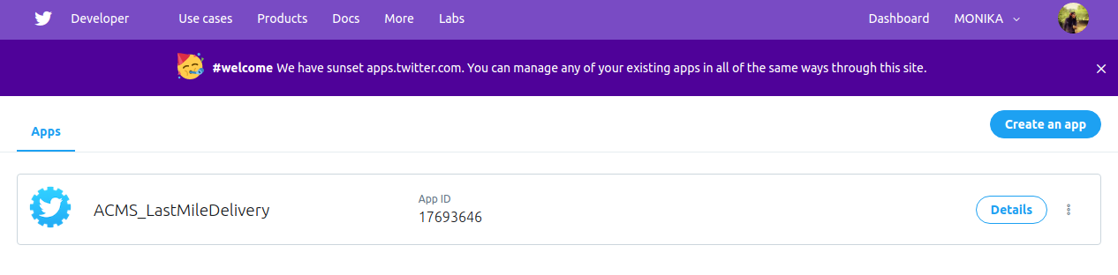
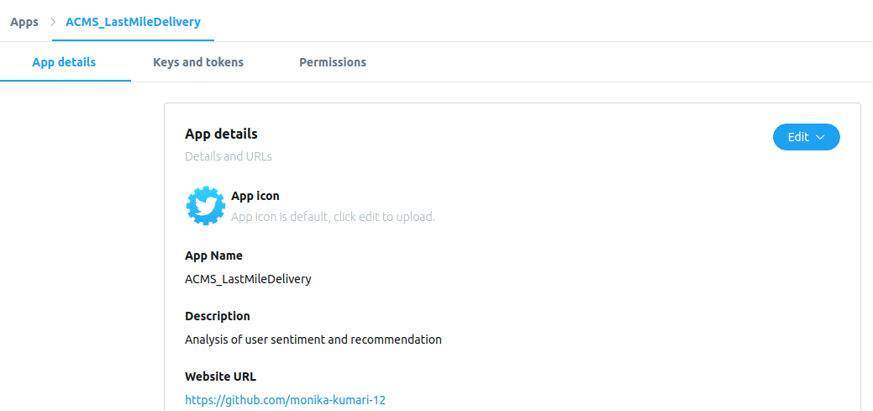
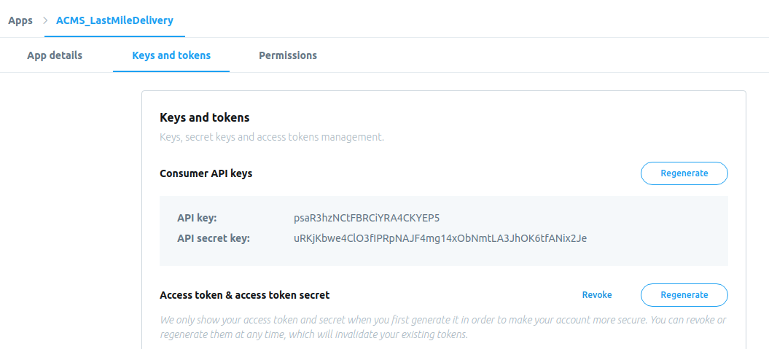
PREPARING AND EXPLORING THE DATA
TWITTER DEVELOPER ACCOUNT
Created a twitter app to extract tweets using
‹#›

Slide 9
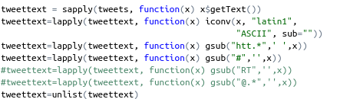
PREPARING AND EXPLORING THE DATA
TEXT CLEANING
Removed URLS, HashTags,RT, @ .
‹#›

Slide 10
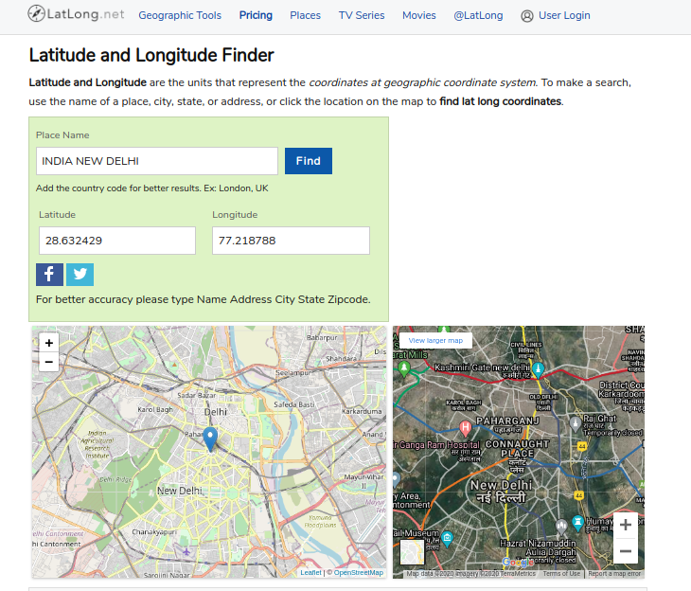

Slide 11
QUESTIONS?

Slide 12
2. ANALYZING THE DATA

Slide 13
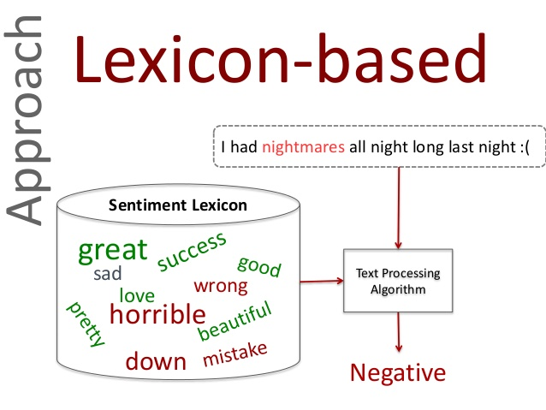
Lexicon Analysis for Sentiment Score
and Polarity
bag of 6800 words

Slide 14
PREPARING AND EXPLORING THE DATA
META DATA
Isretweet, retweet count, favourite , duplicate
‹#›

Slide 15
LIMITATION OF DATA COLLECTION
14 DAYS WINDOW
Low volume search terms and geo specific harvesting
AMOUNT OF SCRAPES PER 15 MIN
It can vary depending on the authentication method you use.
‹#›

Slide 16
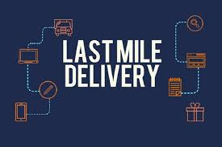

Slide 17

Why Twitter Analysis ?

Slide 18
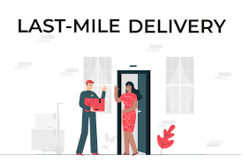
Analysis,Algorithm,Coding

Slide 19
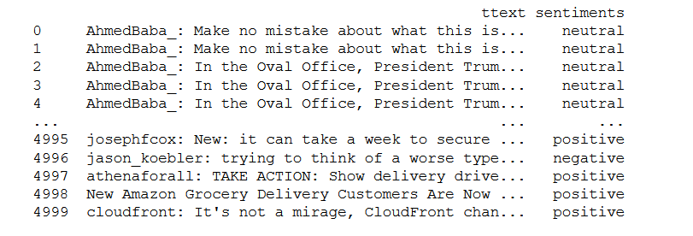
Classifying tweets in positive negative and neutral

Slide 20
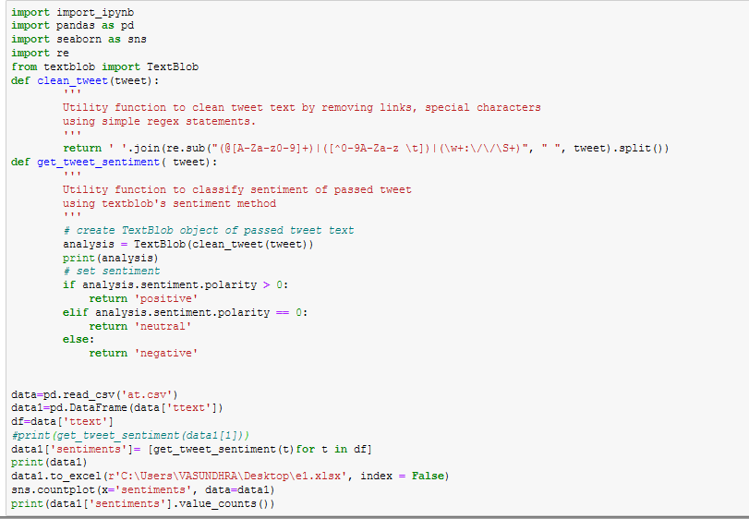
CODE: algorithm 1 For classification

Slide 21
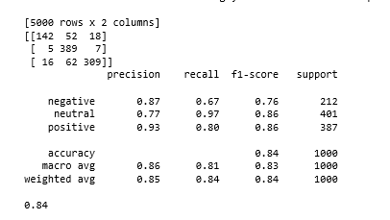
Accuracy of the model

Slide 22
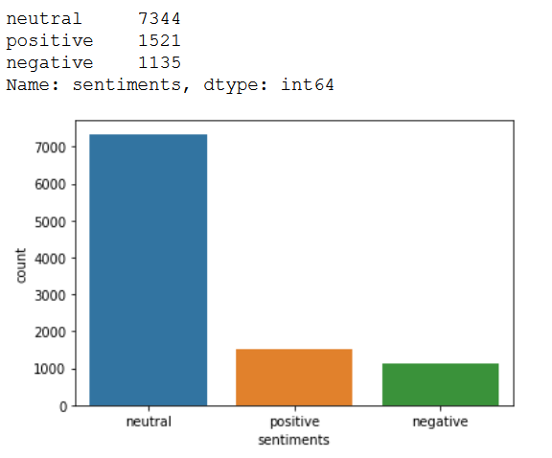
Global positive negative and neutral tweets count graph
Fig 1: Outcome of algorithm 1 of 10k global data set .
Dated: 20th april 2020-4th may 2020

Slide 23
QUESTIONS

Slide 24
3. VISUALIZING THE DATA

Slide 25
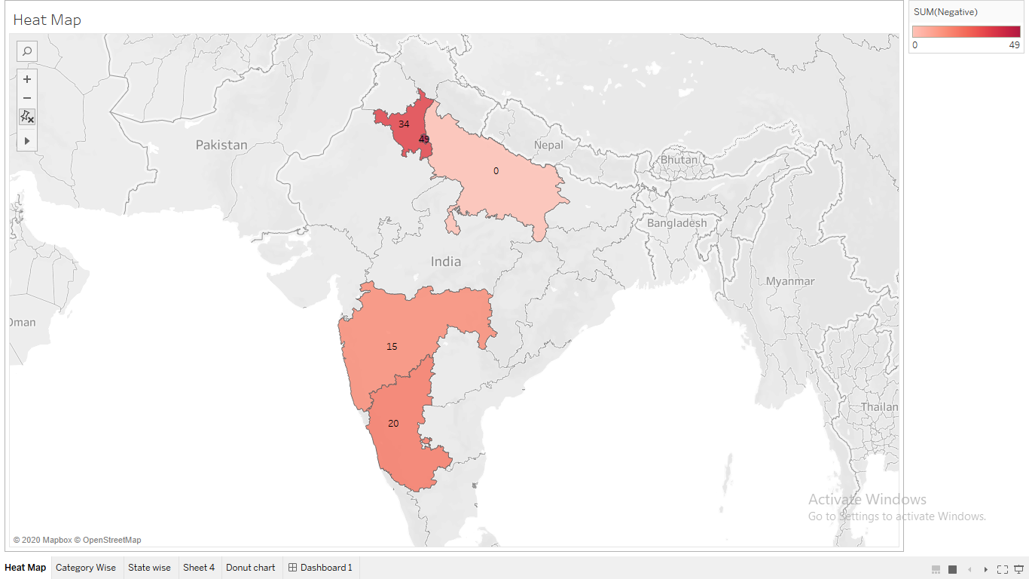

Slide 26
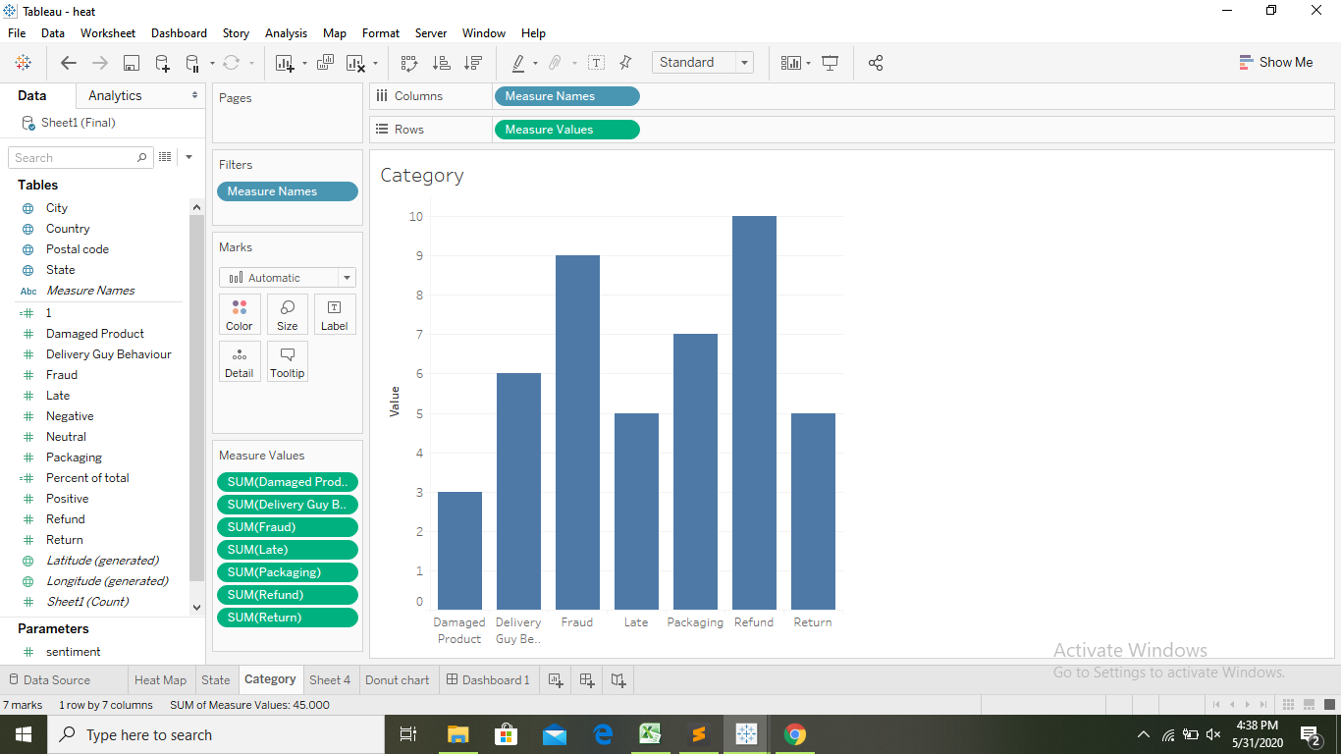

Slide 27
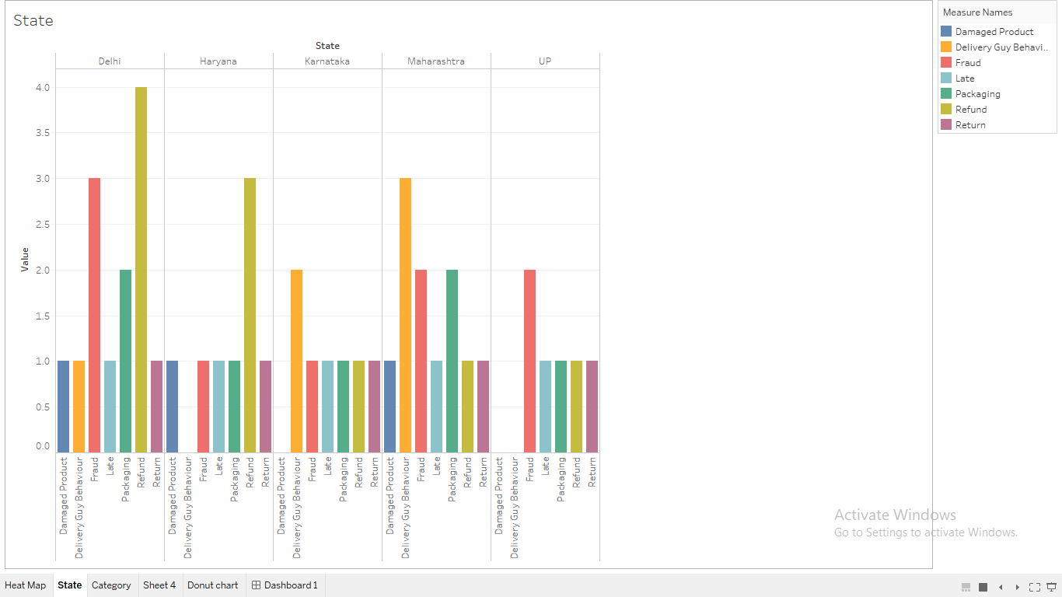

Slide 28
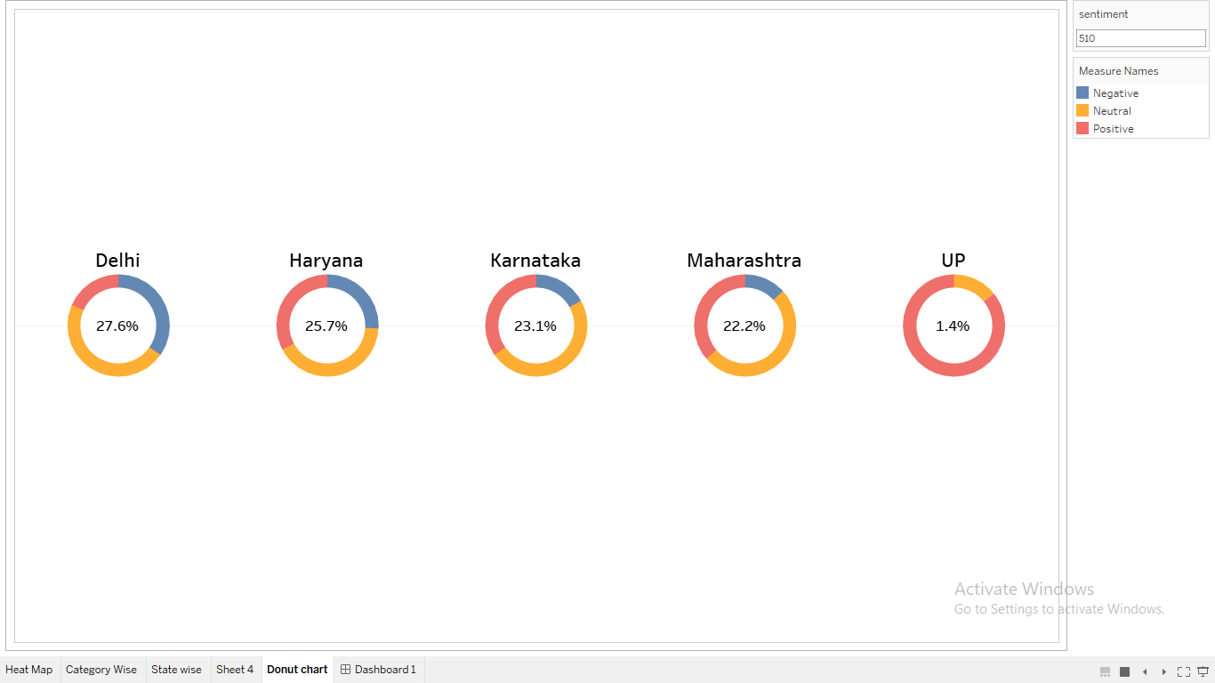
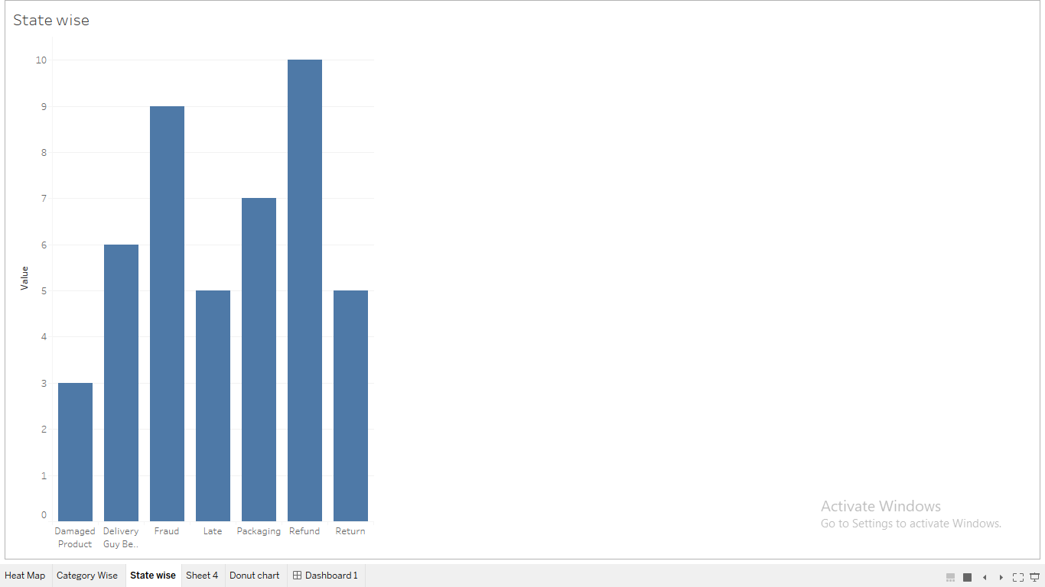

Slide 29
QUESTIONS?

Slide 30
4. PROJECT INSIGHTS

Slide 31
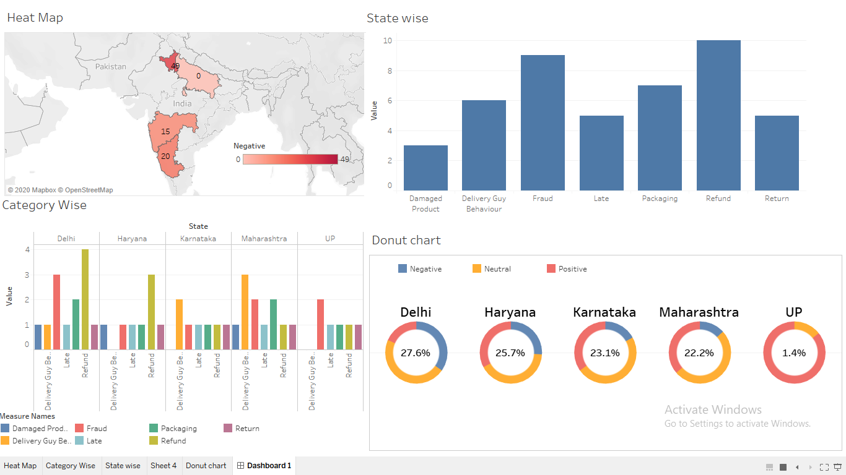

Slide 32
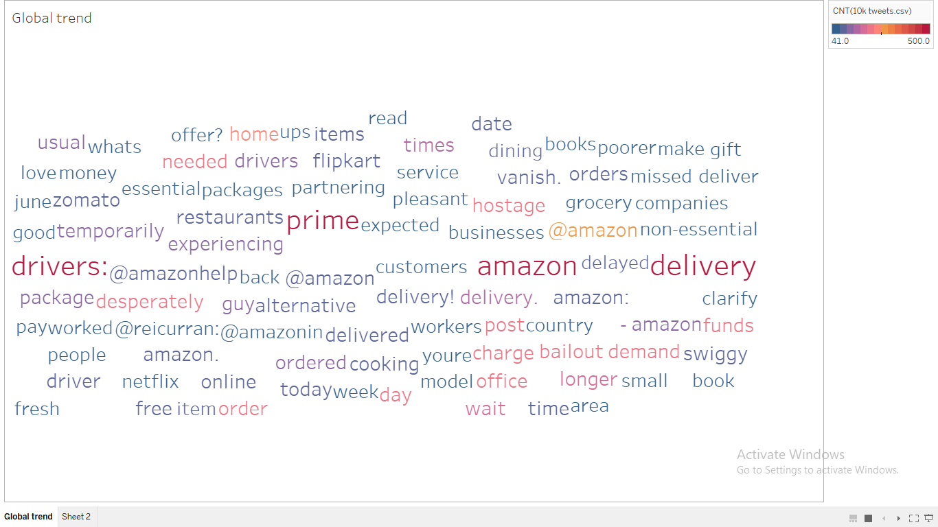

Slide 33
QUESTIONS?

Slide 34
5. KEY LEARNING

Slide 35
FUTURE SCOPE
KEY POINTS
Fake review Detection
Spam detection
Timeline analysis
Sarcastic tweets
Product popularity
‹#›

Slide 36
KEY LEARNING FROM ACMS PROGRAM
How industry works, which skills are in demand, Which tools and technologies amazon use.
Amazon always makes sure that the customer problem is addressed irrespective of cost involved.
Six core values of Amazon
1. Customer
2. Ownership
3.Frugality
4.High Hiring Bar
5.Bias for Action
6. Innovation
14 leadership principles
1.Customer Obsession
2. Ownership
3.Invent and Simplify
4.Learn and Be Curious
5.Think Big
6. Have Backbone, disagree and commit…….
‹#›

Slide 37
QUESTIONS?

